Slide 1
ECE 532
CHAPTER 1: REVISION OF COMPUTER PROGRAMMING CONCEPT (FUNCTION PART 2)
Lecturer: Dr. Roslina Mohamad
Room: Tower 2, Level 13, No:14C

Slide 2
Learning Outcomes
At the end of this lecture, you will be able to:
Discover the difference between value and reference parameters
Explore reference parameters and value-returning functions

Slide 3
Learning Outcomes
FUNCTION
PART 2– PASS-BY-REFERENCE FUNCTION
1)VOID FUNCTION

Slide 4
Pass-by-Reference Function
pass-by-reference
With pass-by-reference, the caller gives the called function the ability to access the caller’s data directly, and to modify that data.
A reference parameter is an alias for its corresponding argument in a function call.

Slide 5
Reference Variables
A reference variable is an alias for another variable
It is defined with an ampersand (&) in the prototype and in the header
void getDimensions(int&, int&);
Changes to a reference variable are made to the variable it refers to
Use reference variables to implement passing parameters by reference

Slide 6
Pass by Reference Example
void squareIt(int &); //prototype
void squareIt(int &num)
{
num *= num;
}
int localVar = 5;
squareIt(localVar); // localVar now
// contains 25
//See Example 1.35

Slide 7
Example Pass by Reference
See Example 1.36,
Example 1.37

Slide 8
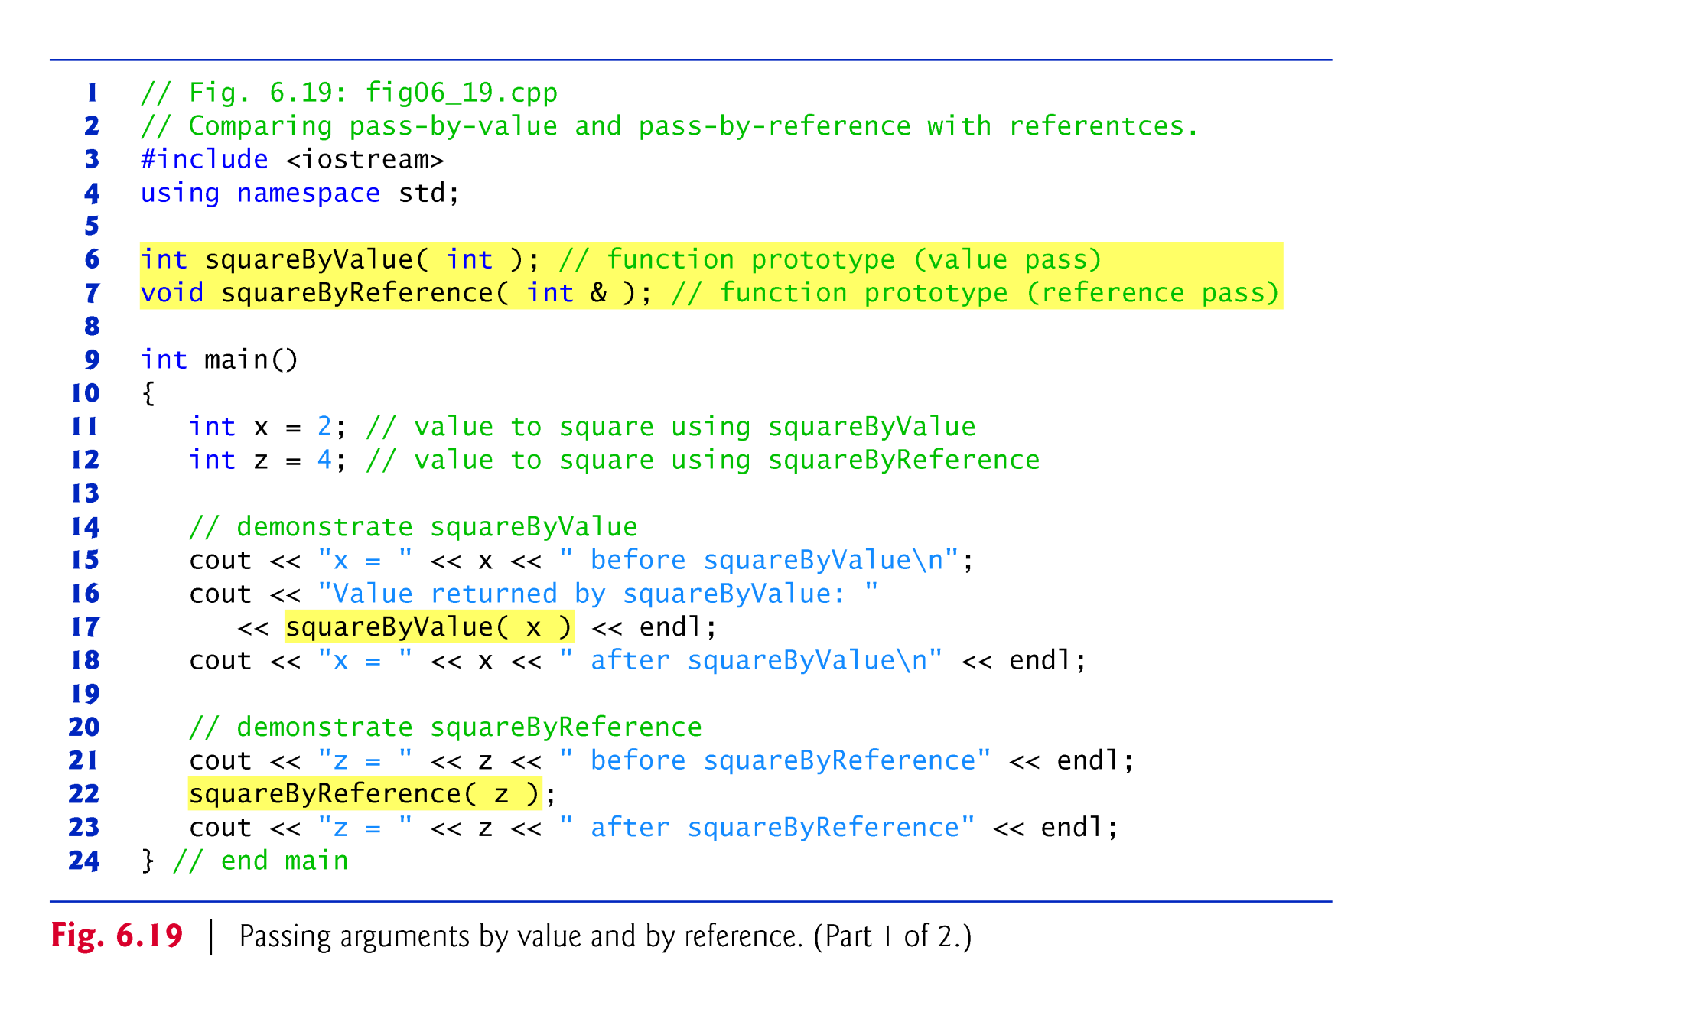

Slide 9
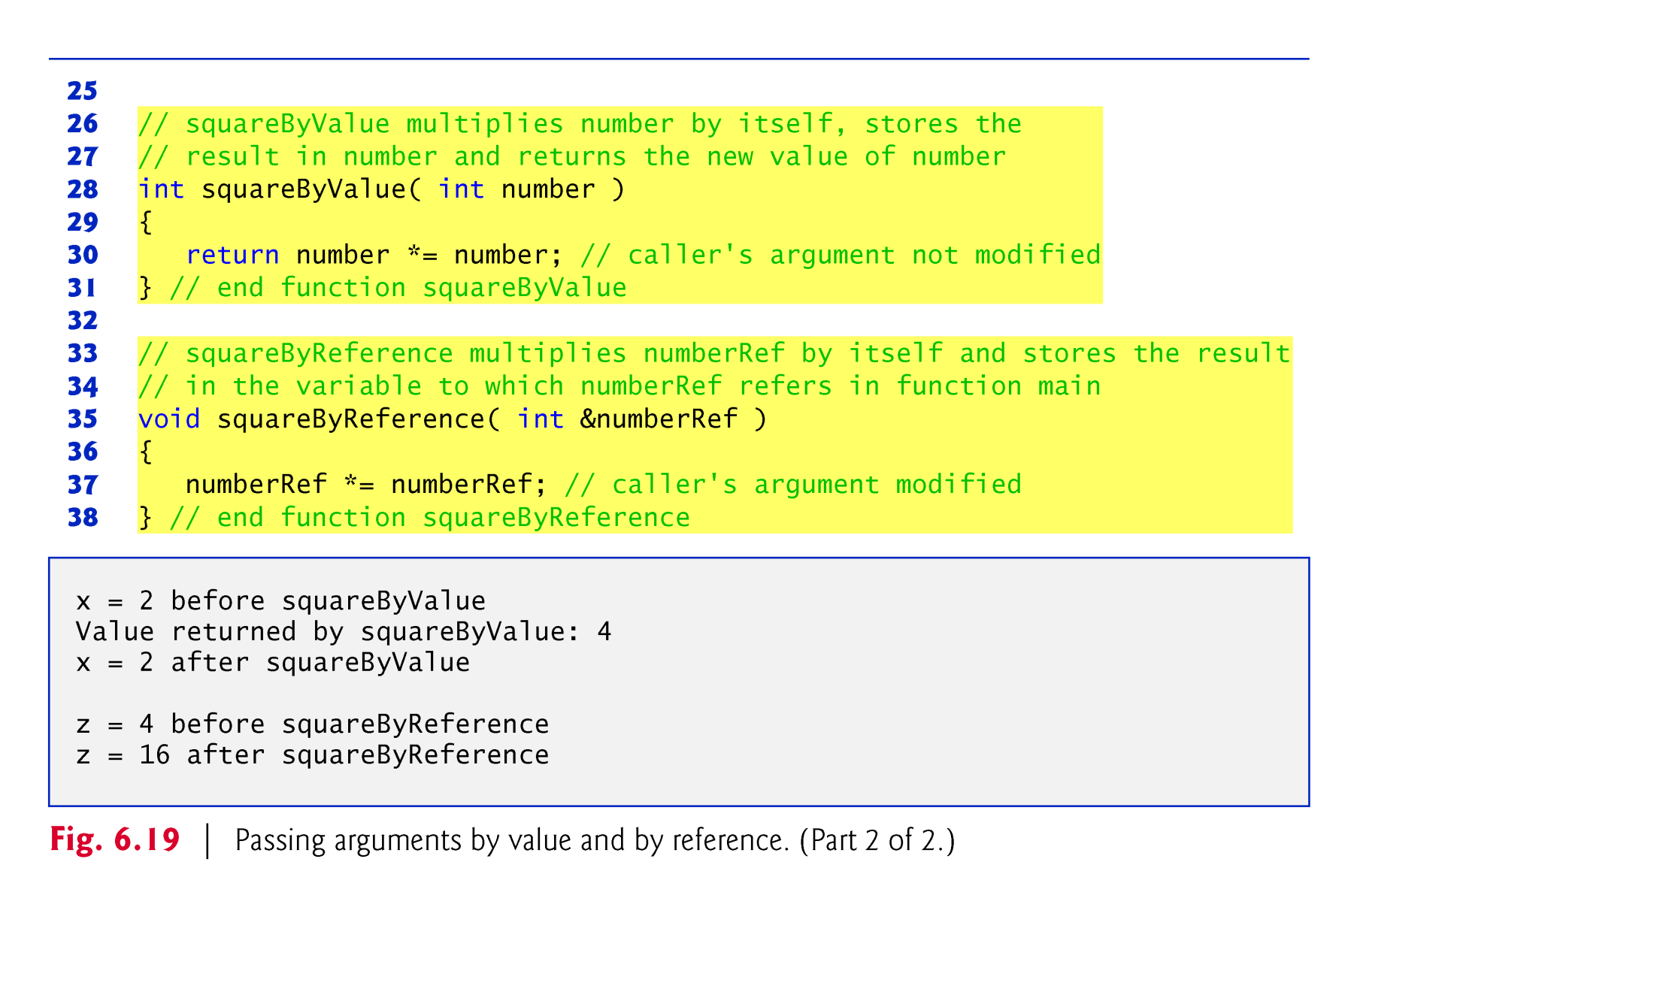

Slide 10
Pointers as Function Parameters
A pointer can be a parameter
It works like a reference parameter to allow changes to argument from within a function
A pointer parameter must be explicitly dereferenced to access the contents at that address

Slide 11
Pointers as Function Parameters
Requires:
1) asterisk * on parameter in prototype and
heading
void getNum(int *ptr);
2) asterisk * in body to dereference the pointer
cin >> *ptr;
3) address as argument to the function in the call
getNum(&num);
//See Example 1.38

Slide 12
Pointers as Function Parameters
void swap(int *x, int *y)
{
int temp;
temp = *x;
*x = *y;
*y = temp;
}
int num1 = 2, num2 = -3;
swap(&num1, &num2); //call
//See Example 1.39

